Slide 1
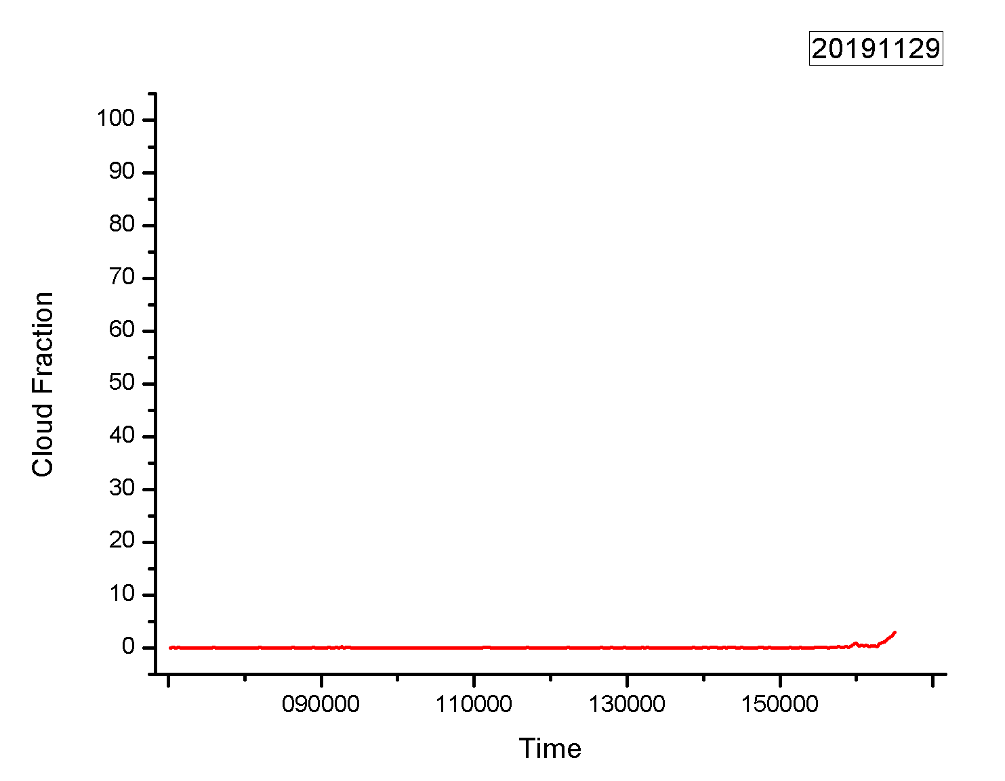
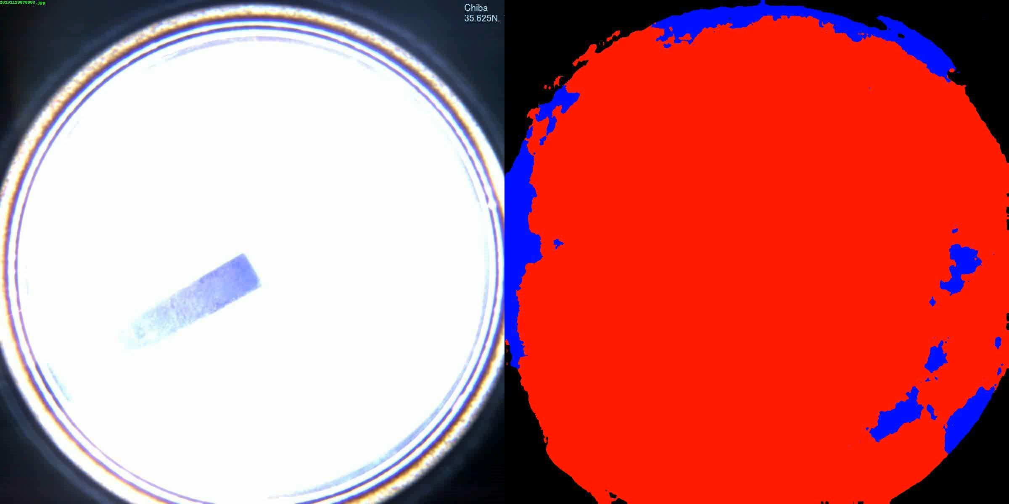
Cloud Fraction
2019.11.29
The video about skyview images and their segmentation
Cloud fraction

